Slide 1
Variational Auto-Encoders (Part 1)

Slide 2
What we’ll learn about Variational Auto-Encoders:
Part 1 (this video): The “simple” explanation of a VAE, as a regularized AE
Architecture of a Variational Auto-Encoder (VAE)
How to train VAEs
How do different terms of training loss influence what VAE learns
How does a VAE relate to the basic AE
Part 2: Applications of VAE for…
Generation of new data points
Modifying data via interpolating between 2 inputs
Modifying specific feature of an input
Compression and Reconstruction

Slide 3
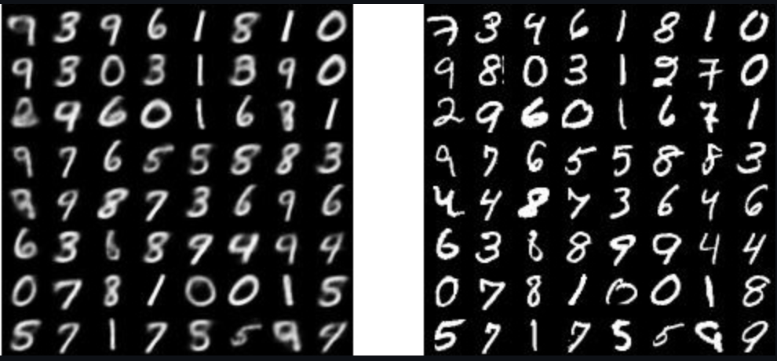
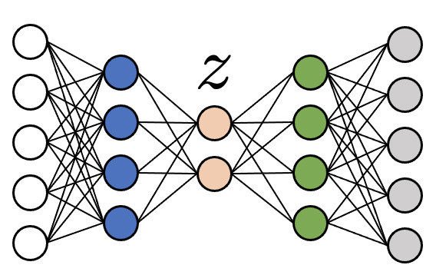
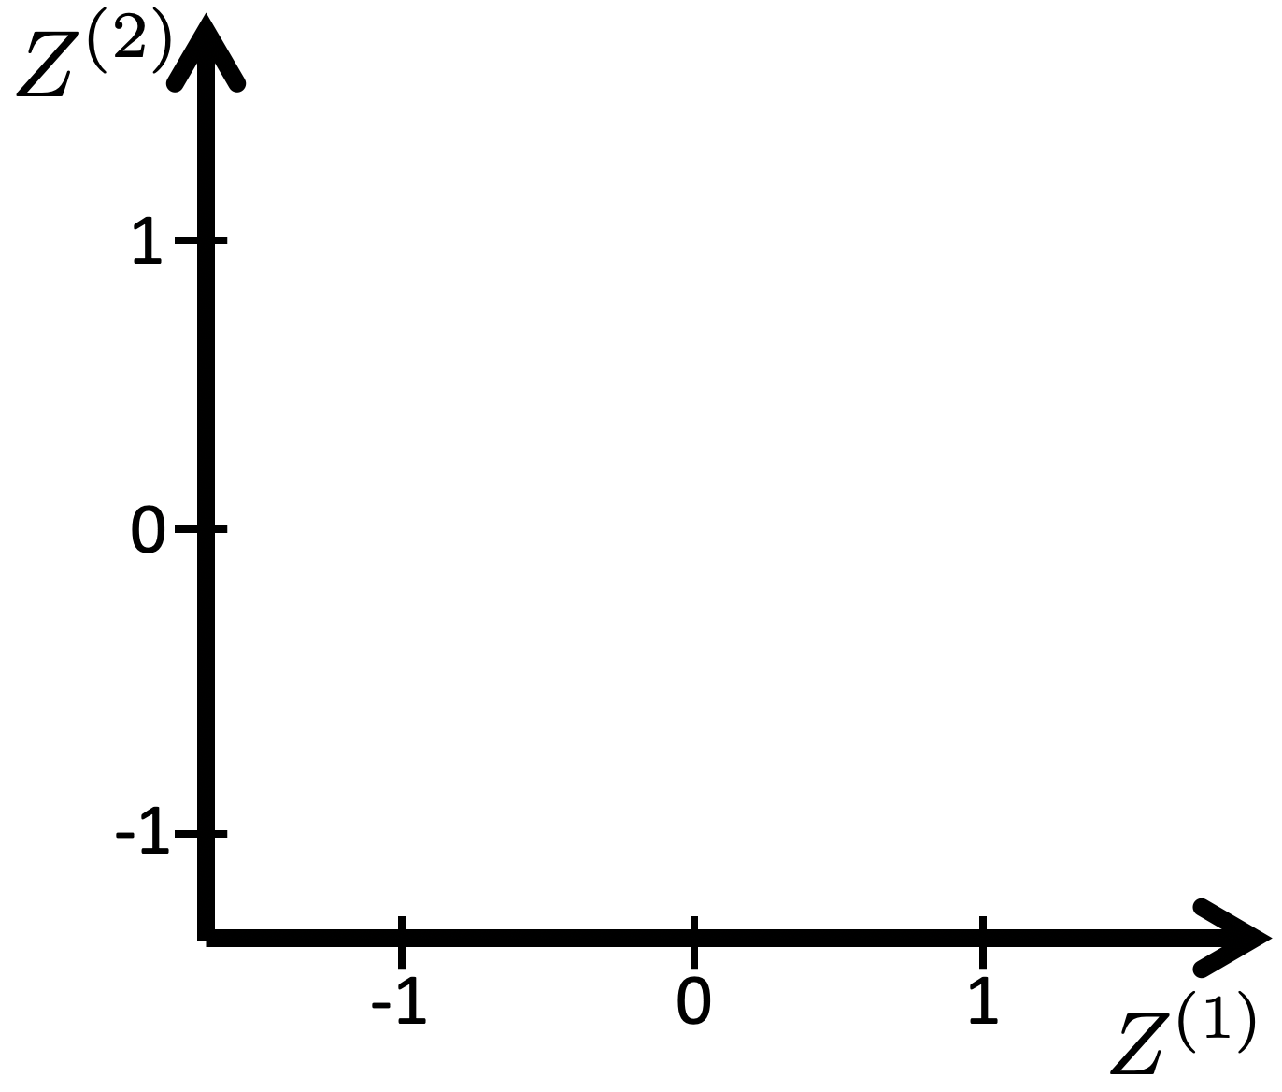
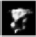
From basic deterministic AE to Variational AE
Generation: If z is sampled from space left empty during training, decoding will fail
Basic AE:
During training, learn to map each input to a point.
sample
Encoder leaves space between mapped points, to enable reconstruction without confusion

Slide 4
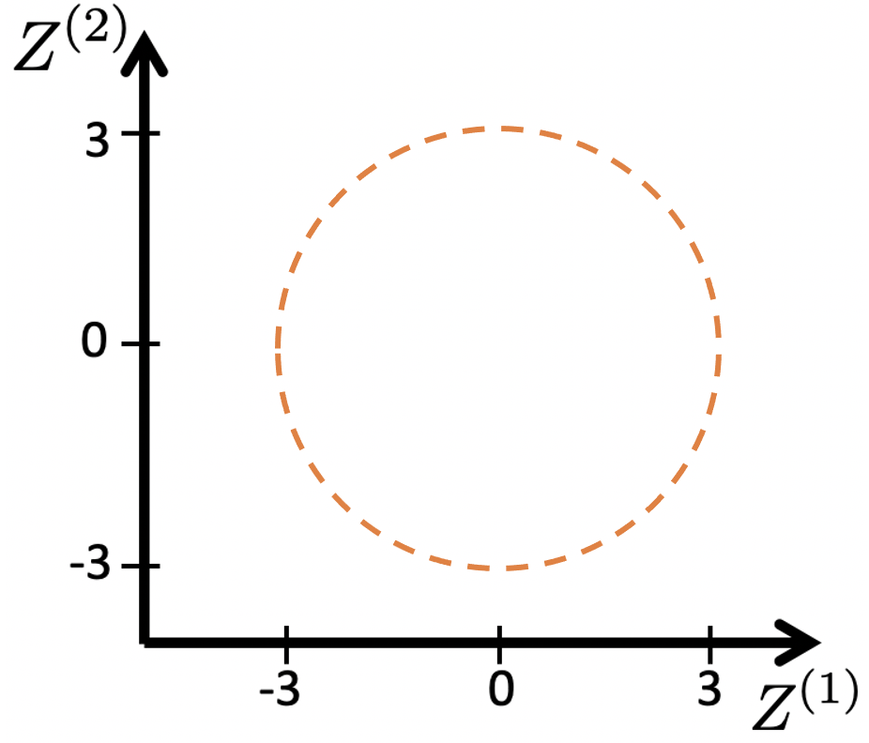
From basic deterministic AE to Variational AE
VAE (informally):
Training: Enforce codes z to cover a specified area
sample
Generation: We can then sample from anywhere in the area. Decoding should then work.
Basic AE:
During training, learn to map each input to a point.
sample
Encoder leaves space between mapped points, to enable reconstruction without confusion

Slide 5
From basic deterministic AE to Variational AE
VAE (informally):
Training: Enforce codes z to cover a specified area
Instead of using Encoder that maps each input to a single point like in basic AE…
sample
Encoder
Generation: We can then sample from anywhere in the area. Decoding should then work.
Basic AE:
During training, learn to map each input to a point.
sample
Encoder leaves space between mapped points, to enable reconstruction without confusion

Slide 6
From basic deterministic AE to Variational AE
VAE (informally):
Training: Enforce codes z to cover a specified area
Make encoder that maps each input to an ‘area’
sample
Encoder
Forces decoder to learn to decode z from whole covered area.
Generation: We can then sample from anywhere in the area. Decoding should then work.
During training, learn to map each input to a point.
sample
Encoder leaves space between mapped points, to enable reconstruction without confusion

Slide 7
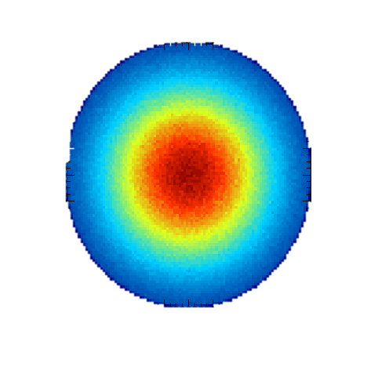
From basic deterministic AE to Variational AE
VAE (more accurately):
Training: Enforce codes z to follow a “prior” distribution p(z)
sample
Generation: We can then sample from prior p(z) and decode!
During training, learn to map each input to a point.
sample
Encoder leaves space between mapped points, to enable reconstruction without confusion

Slide 8
From basic deterministic AE to Variational AE
VAE (more accurately):
Training: Enforce codes z to follow a “prior” distribution p(z)
Learn encoder that predicts codes z that follow distribution p(z)
sample
Encoder
Forces decoder to learn to decode z from whole p(z).
Generation: We can then sample from prior p(z) and decode!
During training, learn to map each input to a point.
sample
Encoder leaves space between mapped points, to enable reconstruction without confusion

Slide 9
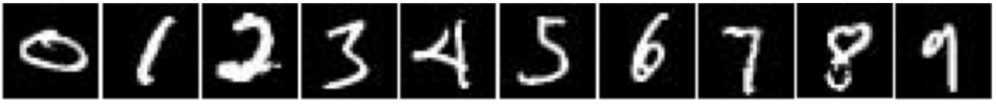
1. Probabilistic Encoder
Basic AE:
Each input x is mapped to a point z
The whole model is deterministic.
-1
0
1
sample
-1
0
1
-1
0
1
-1
0
1

Slide 10
1. Probabilistic Encoder
“posterior” distribution of z, a.k.a. “conditional” distribution of z given x
Each x is mapped to a multi-variate Normal/Gaussian distribution of z, by predicting a mean and standard deviation for each dimension of z. (Note: diagonal covariance matrix, i.e. each dimension is uncorrelated)
sample
Basic AE:
Each input x is mapped to a point z
-1
0
1
sample
-1
0
1
-1
0
1
-1
0
1

Slide 11
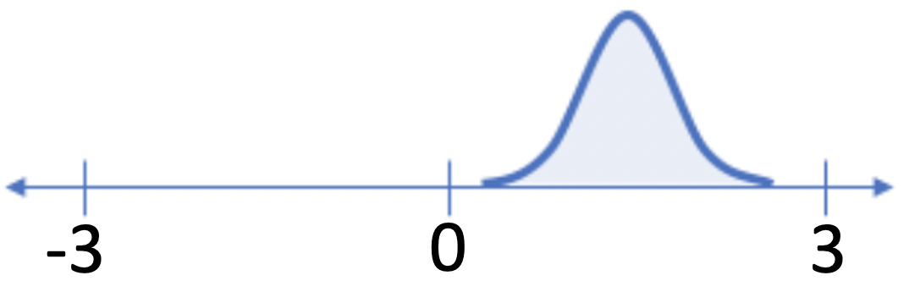
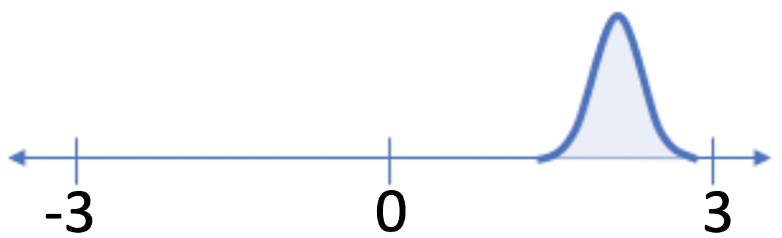
1. Probabilistic Encoder
“posterior” distribution of z, a.k.a. “conditional” distribution of z given x
Each x is mapped to a multi-variate Normal/Gaussian distribution of z, by predicting a mean and standard deviation for each dimension of z. (Note: diagonal covariance matrix, i.e. each dimension is uncorrelated)
sample
Basic AE:
Each input x is mapped to a point z
-1
0
1
sample
-1
0
1
-1
0
1
-1
0
1

Slide 12
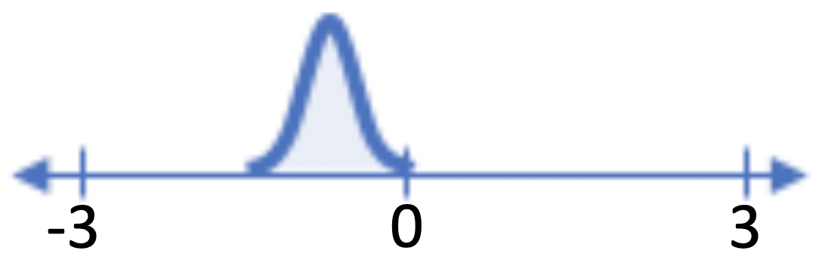
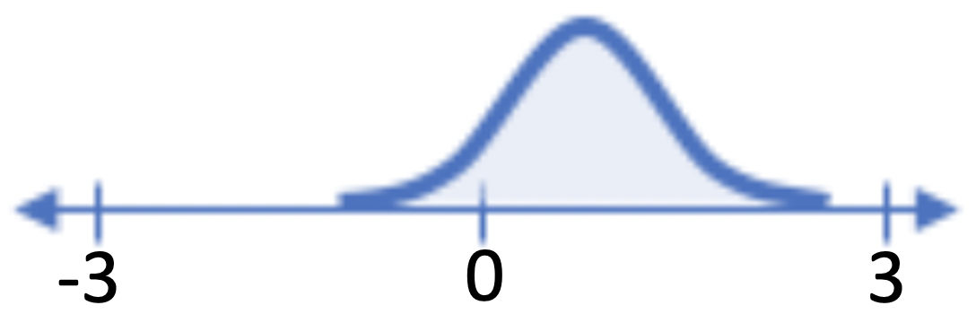
1. Probabilistic Encoder
“posterior” distribution of z, a.k.a. “conditional” distribution of z given x
Each x is mapped to a multi-variate Normal/Gaussian distribution of z, by predicting a mean and standard deviation for each dimension of z. (Note: diagonal covariance matrix, i.e. each dimension is uncorrelated)
sample
Basic AE:
Each input x is mapped to a point z
-1
0
1
sample
-1
0
1
-1
0
1
-1
0
1

Slide 13
1. Probabilistic Encoder
“posterior” distribution of z, a.k.a. “conditional” distribution of z given x
Each x is mapped to a multi-variate Normal/Gaussian distribution of z, by predicting a mean and standard deviation for each dimension of z. (Note: diagonal covariance matrix, i.e. each dimension is uncorrelated)
sample
The final layer of VAE’s encoder has 2 times the number of neurons than the encoder of a standard AE.
For z of dimension v, , encoder of VAE has neurons.
For each dimension of z, the standard AE’s encoder predicts one value, the code. The AE’s encoder is deterministic.
For each dimension of z, the VAE’s encoder predicts the mean and standard deviation of a Gaussian distribution.
This distribution describes “which values of z are likely the correct code” for input x. VAE’s encoder is probabilistic/stochastic.

Slide 14
A closer look

Slide 15
How to interpret that for each input x, the encoder predicts a probability distribution for z?
VAE’s encoder expresses “uncertainty”:
For each sample x, the Gaussian distribution of z predicted by the encoder, expresses how “likely” is that a specific value of z is the correct code for x.
In probabilistic terms, it expresses the conditional probability of z given x, , according to the model (encoder) with parameters .

Slide 16
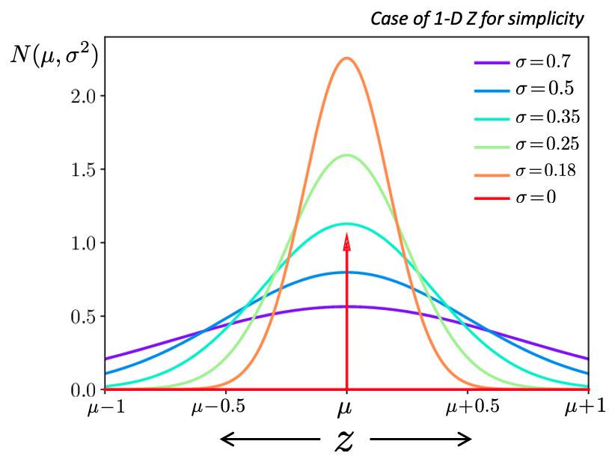
Uncertainty (low probability) in encoding
Q: If predicted std. deviation ?
A: Totally certain (prob=1) that z is the predicted mean!
This is the basic Auto-Encoder’s behavior!
Larger standard deviation => larger range of values z may be the correct code of x => less certainty (probability) each of these z values is the “ideal” code for x.

Slide 17
How to interpret “overlaps” of predicted distributions for z?
?
This formulation of the encoder leads to existence of “overlaps” in the encoding of different samples.
(in fact, Gaussians extend to infinity, even for very small values, so in fact, there are overlaps everywhere)
Q: What would be the appearance of an image that would be mapped with a mean in the overlapping area of x₁ and x₂?

Slide 18
How to interpret “overlaps” of predicted distributions for z?
This formulation of the encoder leads to existence of “overlaps” in the encoding of different samples.
(in fact, Gaussians extend to infinity, even for very small values, so in fact, there are overlaps everywhere)
Q: What would be the appearance of an image that would be mapped with a mean in the overlapping area of x₁ and x₂?
A: Appearance that would be in-between those of x₁ and x₂

Slide 19
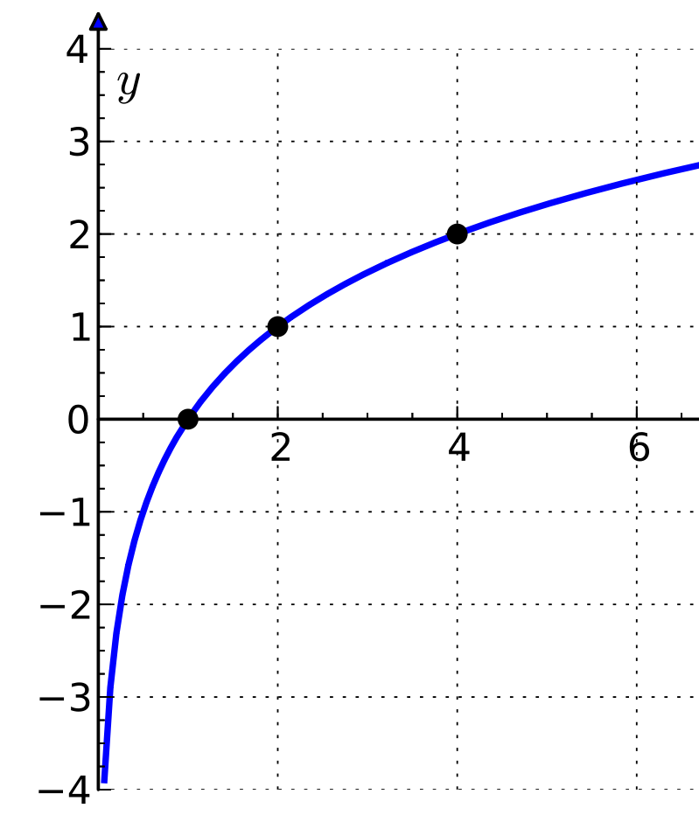
Implementation trick: predict log(std.dev.)
Standard deviation *must* be positive.
=> Cant use activation functions that allow negatives.
2. Standard deviations for each x tend to be small, close to zero
=> Cant use ReLU. Not good gradients around 0, but std.devs can and will take such low values.
Common solution in implementations:
Treat Encoder as if it predicts
log_stddev = matrix_mult(act_layer1 , w_layer2)
Compute sigma as:
stddev = exp(log_stddev)

Slide 20
2. Stochastic Decoder (during training)

Slide 21
2. Stochastic Decoder (during training)
Step 1. Sample a code from the predicted Gaussian
sample

Slide 22
2. Stochastic Decoder (during training)
Step 1. Sample a code from the predicted Gaussian
sample
Step 2.
Decode with a standard decoder,
similar to a basic AE.

Slide 23
2. Stochastic Decoder (during training)
At each training iteration of SGD, for each input x in the batch, we draw 1 sample.
sample

Slide 24
2. Stochastic Decoder (during training)
At each training iteration of SGD, for each input x in the batch, we draw 1 sample.
sample
However, at different SGD iterations, different samples may be drawn for the same x.
For any input x and predicted
it is more likely that we will sample value that is close to the predicted mean , rather than further.
At different SGD iterations, the decoder should try to reconstruct the input for any drawn sample, even the unlikely ones.

Slide 25
3. Training Objective
sample
What do we want to train this model to do?
Create realistic images with the decoder
Predicted (distributions of) codes to cover the prior p(z)

Slide 26
3. Training Objective
sample
Reconstruction loss
Regularizer
Strength of Regularizer (chosen by us through experimentation)

Slide 27
3. Training Objective
sample
Reconstruction loss
Regularizer
“Minimize the Expected Value of the VAE loss, when x is sampled from the data distribution”
In other words: “Minimize the VAE loss on average over the training data x”

Slide 28
3. Training Objective: Reconstruction loss
sample
Reconstruction loss:
Reconstruct input x, for any sampled from .
Dimensionality of x

Slide 29
3. Training Objective: Reconstruction loss
sample
Reconstruction loss:
The Reconstruction loss is a function of all parameters. Therefore it trains BOTH the encoder AND the decoder.
Function of (encoder params)
Function of (decoder params)

Slide 30
Effect of Reconstruction loss:
sample
Assume that an encoder learns to encode these two digits as shown.
Q: For what values of z do you expect high reconstruction error?
A: Overlapping area

Slide 31
Effect of Reconstruction loss: on the predicted means
sample
Grads of Recon loss encourages learning means of different samples away from each other in latent space
Q: How can the encoder reduce overlapping areas by changing the predicted means? A: Learn parameters that predict means that are away from each other.

Slide 32
Effect of Reconstruction loss: on the predicted means
sample
If we would minimize ONLY the Reconstruction loss, encoder can learn to predict means of p(z|x) that are arbitrarily far. They can take values outside the area covered by the “prior” p(z).

Slide 33
Effect of Reconstruction loss: on the predicted std. deviations
sample
Q: How can the encoder reduce overlapping areas by changing the predicted standard deviations? A: Learn parameters that predict small standard deviations.

Slide 34
Effect of Reconstruction loss: on the predicted std. deviations
sample
Q: How can the encoder reduce overlapping areas by changing the predicted standard deviations? A: Learn parameters that predict small standard deviations.

Slide 35
Effect of Reconstruction loss: on the predicted std. deviations
sample
Q: How can the encoder reduce overlapping areas by changing the predicted standard deviations? A: Learn parameters that predict small standard deviations.

Slide 36
Effect of Reconstruction loss: on the predicted std. deviations
sample
If we would minimize ONLY the Reconstruction loss,
“ideal” standard deviations for reconstruction loss are zero for every x!

Slide 37
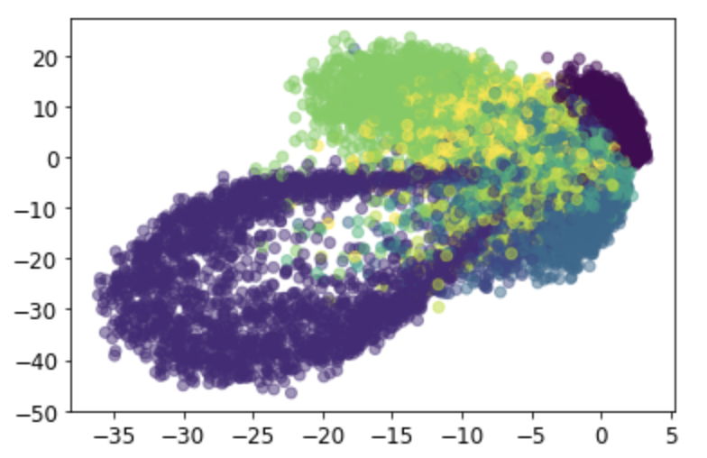
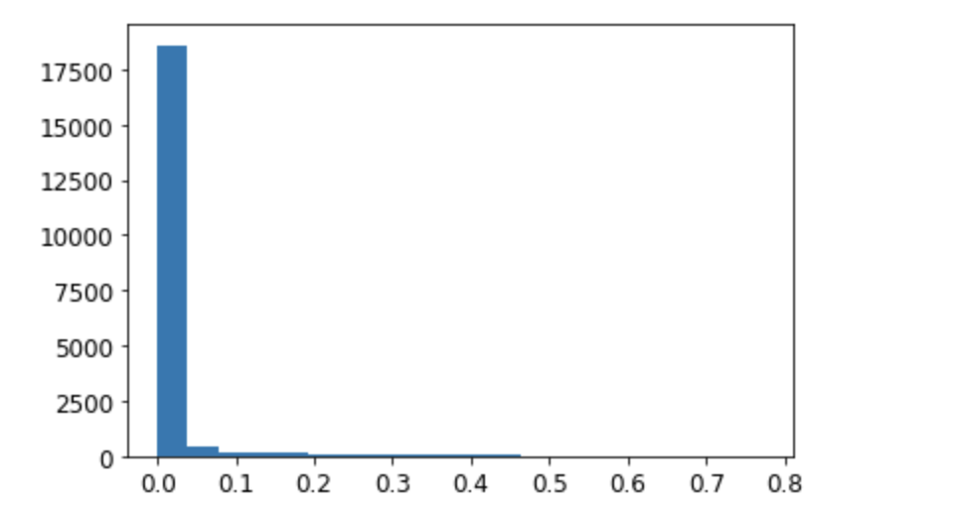
Influence of Reconstruction loss:
If we would train the VAE to only minimize the Reconstruction loss:
Means in 2D space of Z:
Histogram of Std. Deviations
For each x, predicted means:
Dissimilar x to different means of z. More similar samples can be closer.
Means are pushed to arbitrarily high values
For each x, predicted standard deviations:
Tend to be small, ideally 0.
Distributions p(z|x) tend to collapse to their mean. Therefore cant cover prior p(z).
The encoder tends to become deterministic.
If we would train a VAE only with the Reconstruction loss, its learned parameters would make it behave exactly like the basic deterministic AE!
So, the “probabilistic encoder” architecture is not sufficient! We need the Regularizer!

Slide 38
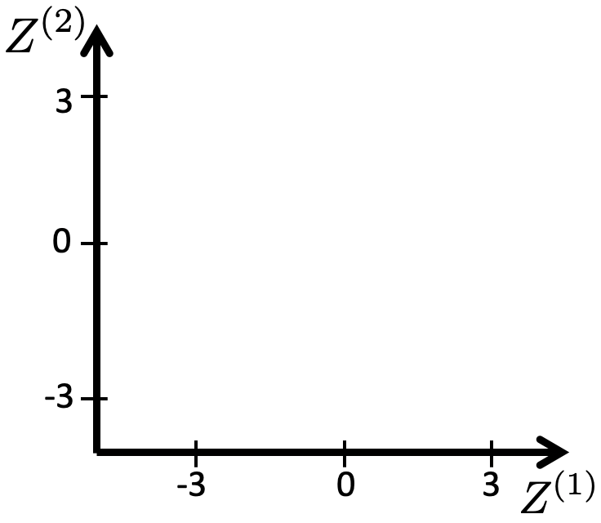
3. Training Objective: Regularizer
“Expected value (average over training data) of the Kullback-Leibler (KL) Divergence” between two distributions
Measure of difference between 2 distributions
The “prior” distribution of codes,

Slide 39
3. Training Objective: Regularizer
What this regularizer does:
“Learn encoder parameters such that on average over the training data, we minimize the “Kullback Leibler (KL) Divergence” between the predicted posterior distribution of z codes, , and the Gaussian distribution “
Measure of difference between 2 distributions
A “prior” distribution of codes,

Slide 40
3. Training Objective: Regularizer
In the specific case of KL divergence between two Gaussian distributions, it is equal to:
Predicted ”posterior” distribution of z for given x,
A “prior” distribution of codes,

Slide 41
3. Training Objective: Regularizer
The regularizer is ONLY a function of ,
the parameters of the encoder!
It does NOT train the decoder!
Predicted ”posterior” distribution of z for given x,
A “prior” distribution of codes,

Slide 42
Effect of Regularizer on means and standard deviations:
To minimize the regularizer….
…for each of dimensions of z…
…mean² must be minimized, which means ideally the predicted means must be….????
…must be 0!

Slide 43
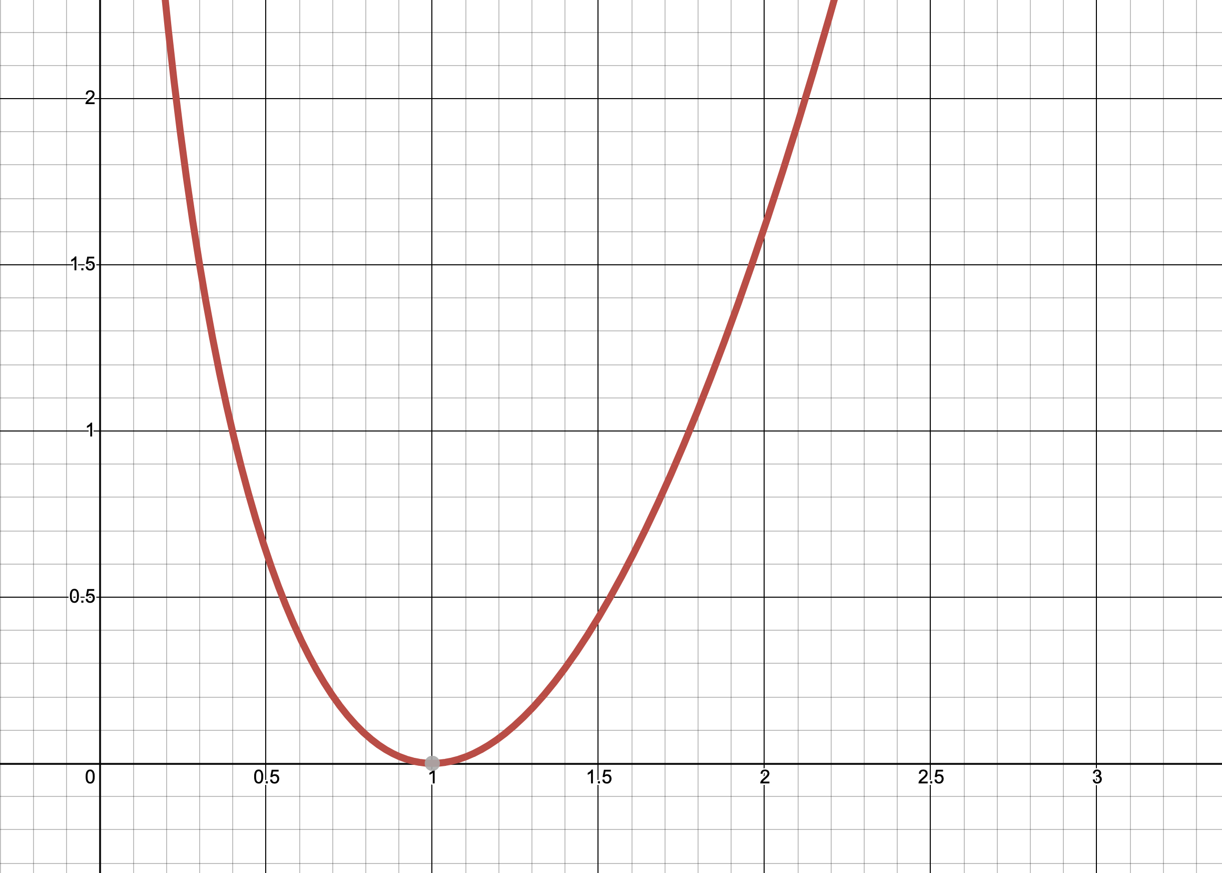
Effect of Regularizer on means and standard deviations:
To minimize the regularizer….
…for each of dimensions of z…
2
…mean² must be minimized, which means ideally the predicted means must be….????
…the predicted standard deviation must ideally be ????….
1
… must be =1 !
…must be 0!
0
1
2

Slide 44
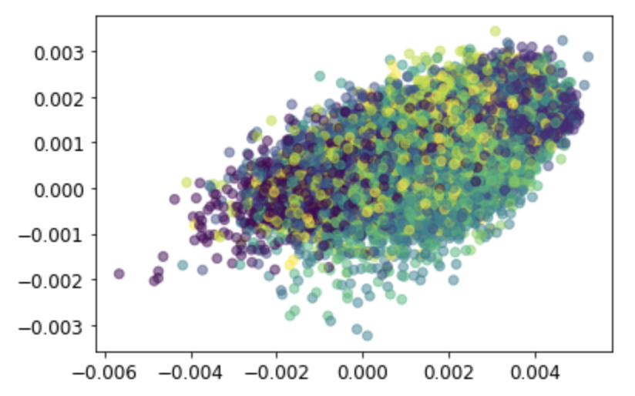
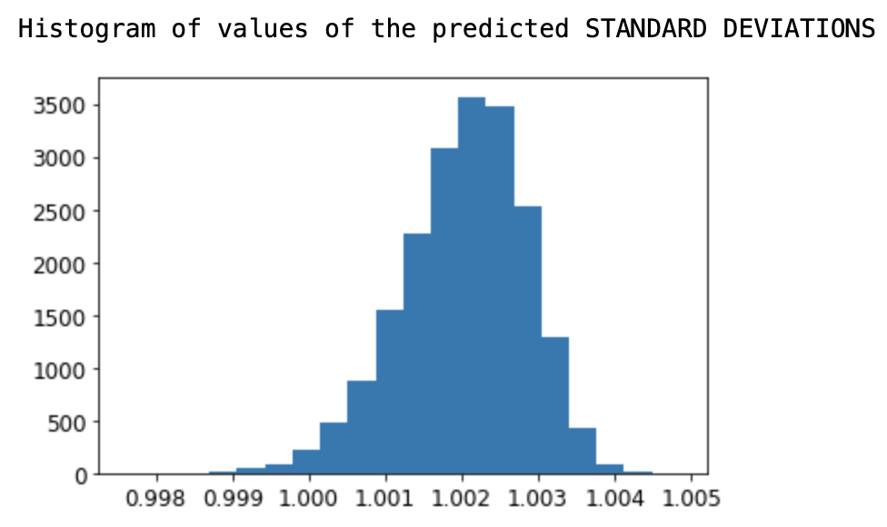
Effect of Regularizer:
If we would train the VAE to only minimize the Regularizer:
Means in 2D space of Z:
Histogram of Std. Deviations
For each x, predicted mean tends to 0.
For each x, predicted std. deviation tends to 1.
For every sample, the predicted posterior p(z|x) takes the shape of the prior p(z)
Useless by itself!
But useful if combined with Reconstruction..!

Slide 45
Combination of the loss terms:
Means that “cluster” the samples
Std.Devs that cover the prior
Small Std.Devs. that reduce overlap
Means around 0
sample
Prior

Slide 46
Combination of the loss terms:
Means that “cluster” the samples
Std.Devs that cover the prior
Small Std.Devs. that reduce overlap
Means around 0
sample
Prior
Under *ideal* optimization: This combination leads that all together (not each individually) the posteriors p(z|x) of the whole training database cover the “prior” N(0,I).* Simultaneously, encoder arranges posteriors of codes such that it facilitates reconstruction.
* The explanation why this happens is in the probabilistic derivation of the VAE (further reading/optional).
and appropriate choice of (via cross-val observing rec loss, means and stds of z)

Slide 47
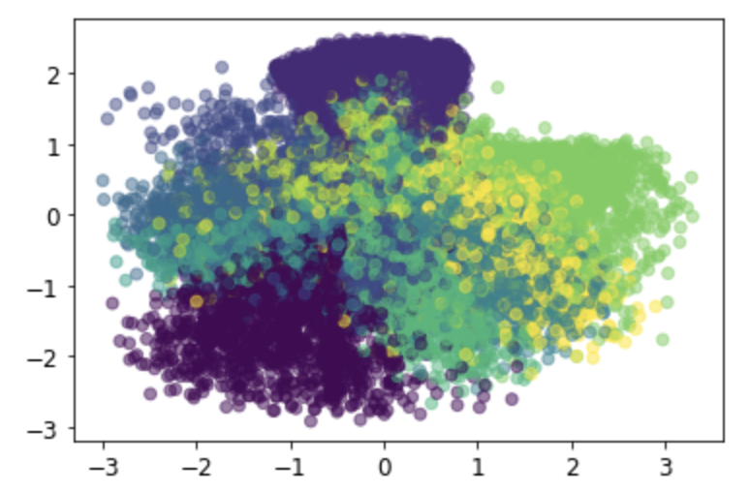
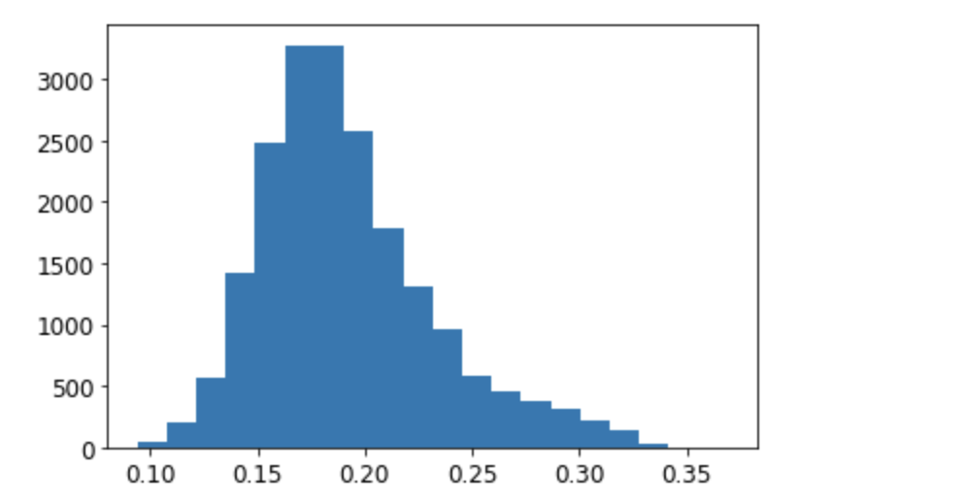
Combination of the loss terms:
Example in practice, with stochastic optimization and non-optimal training parameters:
(from our Tutorial - VAEs on MNIST)
Reconstruction only
Regularizer only
Combination
Means in 2D space of Z:
Means in 2D space of Z:
Means in 2D space of Z:
Histogram of Std. Deviations
Histogram of Std. Deviations
Histogram of Std. Deviations

Slide 48
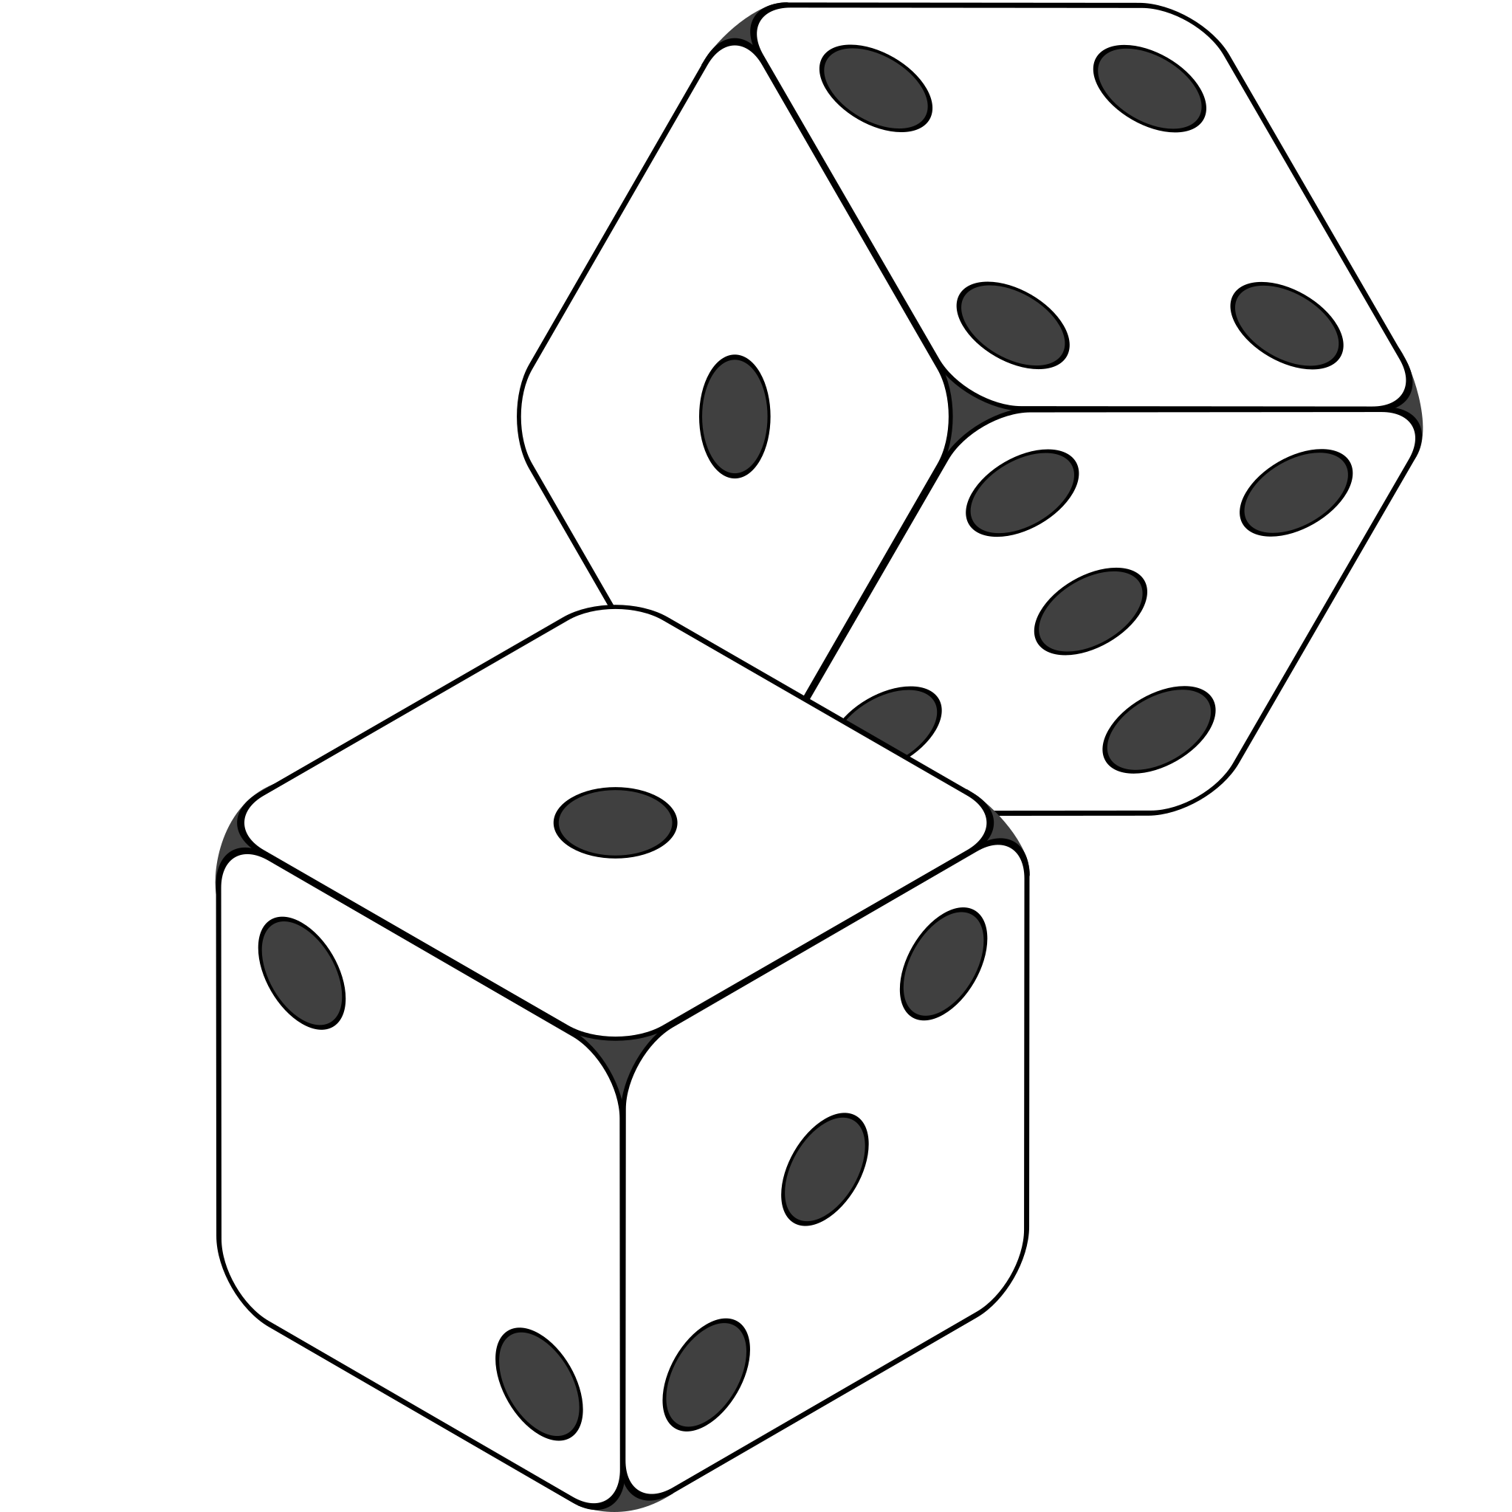
4. Re-parameterization trick
sample
Sampling is not differentiable! No grads!
Solution: The Re-parameterization trick
For a Gaussian (as in VAEs):
This is now differentiable
sample

Slide 49
Bringing everything together: Training
sample
Reparameterization trick
Kingma & Welling, Auto-encoding variational bayes, ICLR 2014
Rezende et al, Stochastic Backpropagation and Approximate Inference in Deep Generative Models, ICML 2014

Slide 50
Bringing everything together: Training
Predicted distributions p(z|x) of all training data together cover the
“prior” distribution of z,
sample
Kingma & Welling, Auto-encoding variational bayes, ICLR 2014
Rezende et al, Stochastic Backpropagation and Approximate Inference in Deep Generative Models, ICML 2014

Slide 51
Bringing everything together: Generating new data
“prior” distribution of z,
sample
Kingma & Welling, Auto-encoding variational bayes, ICLR 2014
Rezende et al, Stochastic Backpropagation and Approximate Inference in Deep Generative Models, ICML 2014

Slide 52
In this video:
What is the architecture of the VAE
What is the training loss: Reconstruction + Regularizer
What is the effect of minimizing each loss term
The Re-Parameterization trick for the sampling
Next video:
Application of VAE for…
Generation of new data points
Modifying data via interpolating between 2 inputs
Modifying specific feature of an input
Compression and Reconstruction

Slide 53
Thank you very much

